Slide 1

Inside an AI Agent: How Tool Contracts and Harnesses Shape Reliable Decisions
MADHAVI PASUMARTHI
@MADHAVIAI

Slide 2
Problem Statement
How do tool contracts and the decisions made across the LLM and agent harness shape answer quality, reliability, safety, latency, and cost?
Audience: Builders creating agentic systems who want to understand their behavior and diagnose where things go wrong.
Focus: Inputs, controls and tool integration boundaries.
What you’ll take away: Decide about what to build, what to change, and where to look when things go wrong in AI Systems.

Slide 3
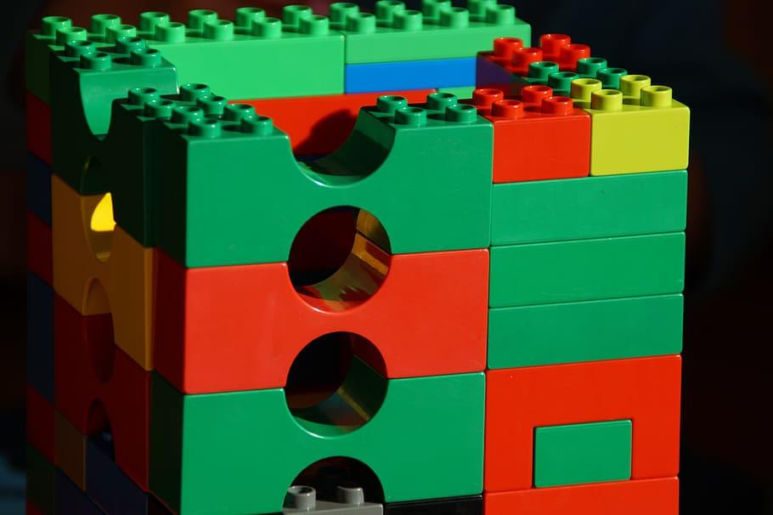
Building blocks of agentic systems
Model — Interprets context and proposes responses or actions.
Tools — Execute capabilities through defined inputs and outputs.
Instructions — Set the purpose, constraints, and expected behavior.
Agent — Uses a model to choose steps and tools toward a goal.
Harness — Runs the agent’s loop and manages context, state, permissions, and limits.
MCP — A standard protocol connecting AI applications to external tools and context.

Slide 4
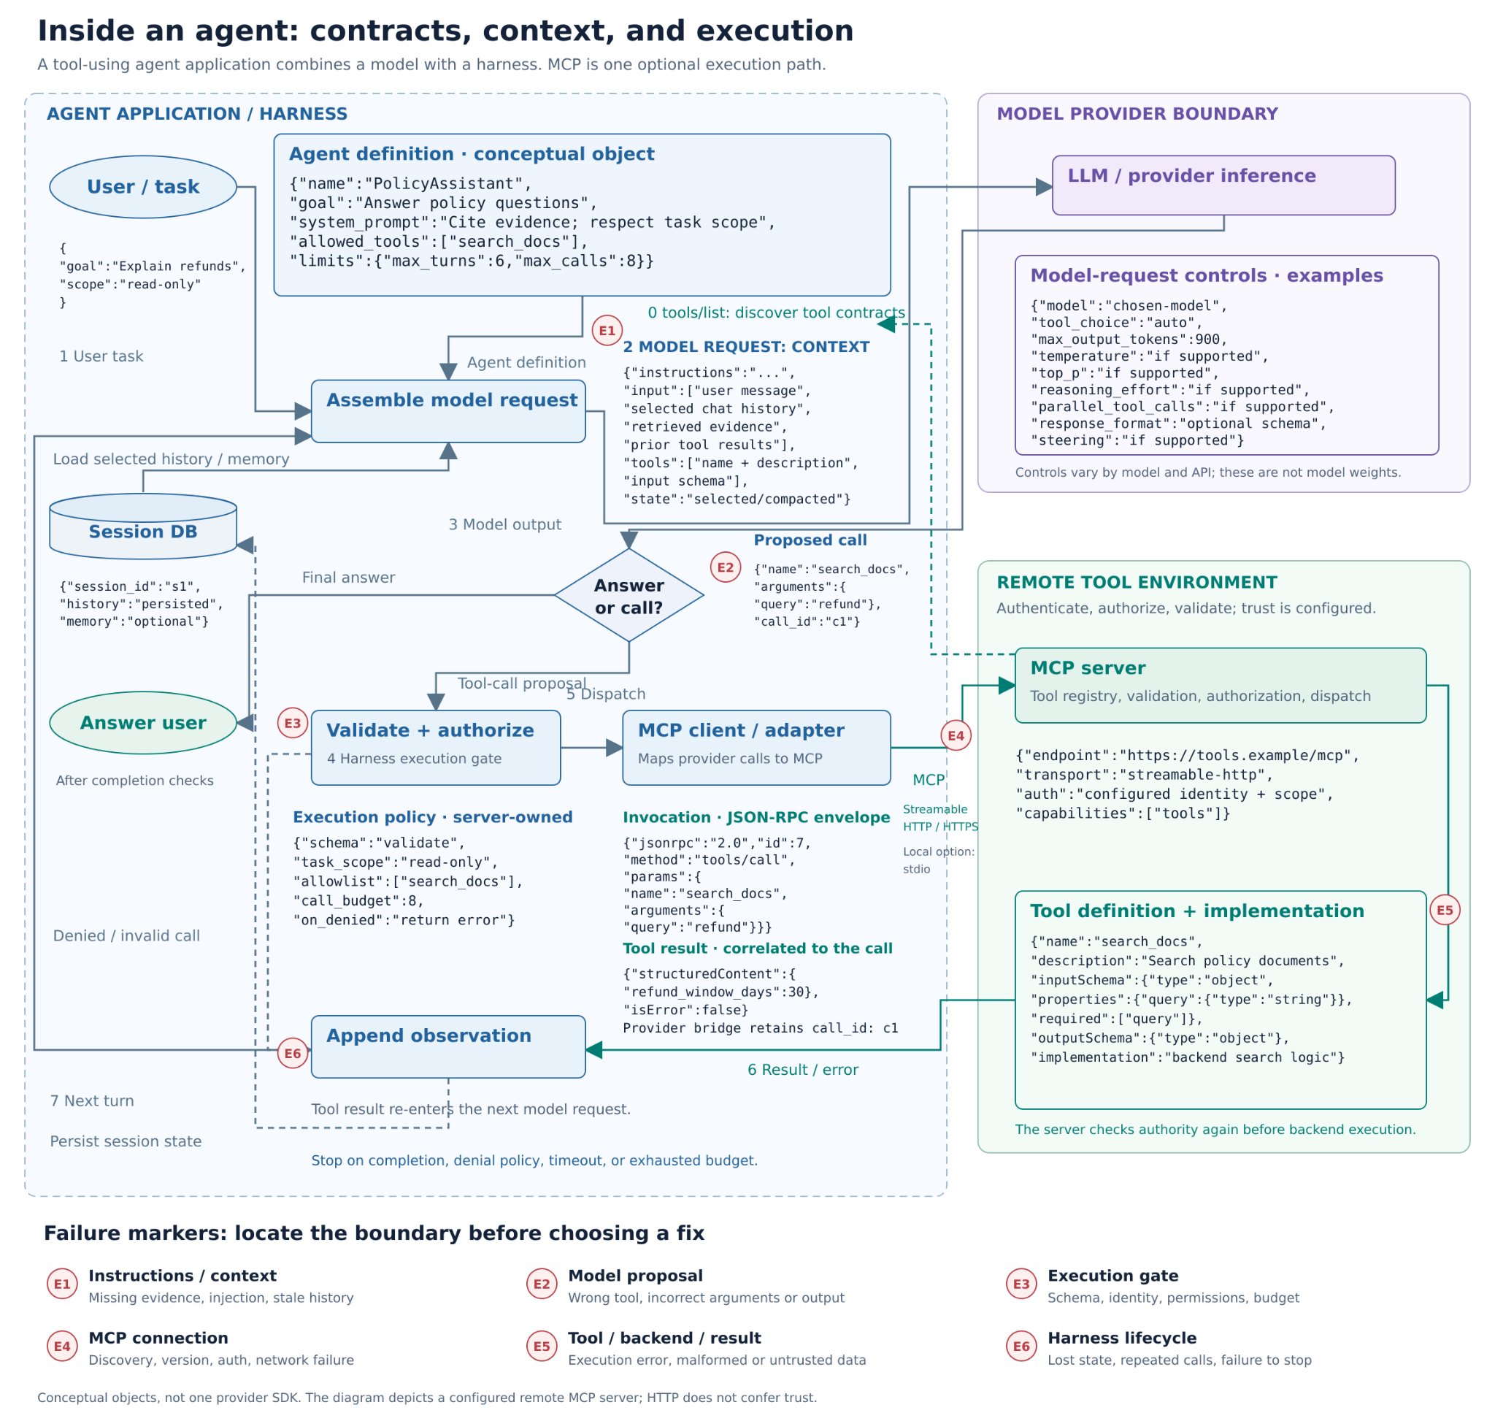

Slide 5
Model family | First generation and initial capabilities | Key expansion stages | Current model examples | Expanded controls and capabilities
OpenAI GPT | GPT-1, 2018: pretrained language understanding, adapted to specific text tasks. | 2023: GPT-3.5/GPT-4 function calling. 2024: Structured Outputs. 2025: Responses API and agent tooling. | GPT-6 Astra; GPT-6.1 Sol and Terra | Reasoning effort; structured tool arguments; asynchronous tool calling; mid-conversation configuration updates; GPT-6 mid-turn steering through Responses WebSocket.
Anthropic Claude | Claude, 2023: conversation, summarization, Q&A, writing, and coding through chat and API. | 2024: tool use generally available. 2025: extended thinking and advanced tool-use facilities. 2026: expanded conversation and managed-session controls. | Claude Opus 5.5; Sonnet 5.5; Haiku 5.5; Fable 5.1 | Adaptive thinking and effort; thinking guidance; per-message effort updates; mid-conversation instruction/tool changes; Managed Agents steering and interruption. Some controls remain beta.
Google Gemini | Gemini 1.0, 2023: multimodal model family with text, image, audio, video, and code capabilities; availability varied by version. | 2024: Gemini 1.5 expanded long-context processing. Later generations added thinking controls and broader agent tooling. | Gemini 4 Argon; Gemini 3.8 Flash | Tunable thinking levels; function calling; structured outputs; grounding and code execution; preserved thought signatures; background long-decode generation. Nonblocking tool calls are a separate, model-specific Live API capability.

Slide 6
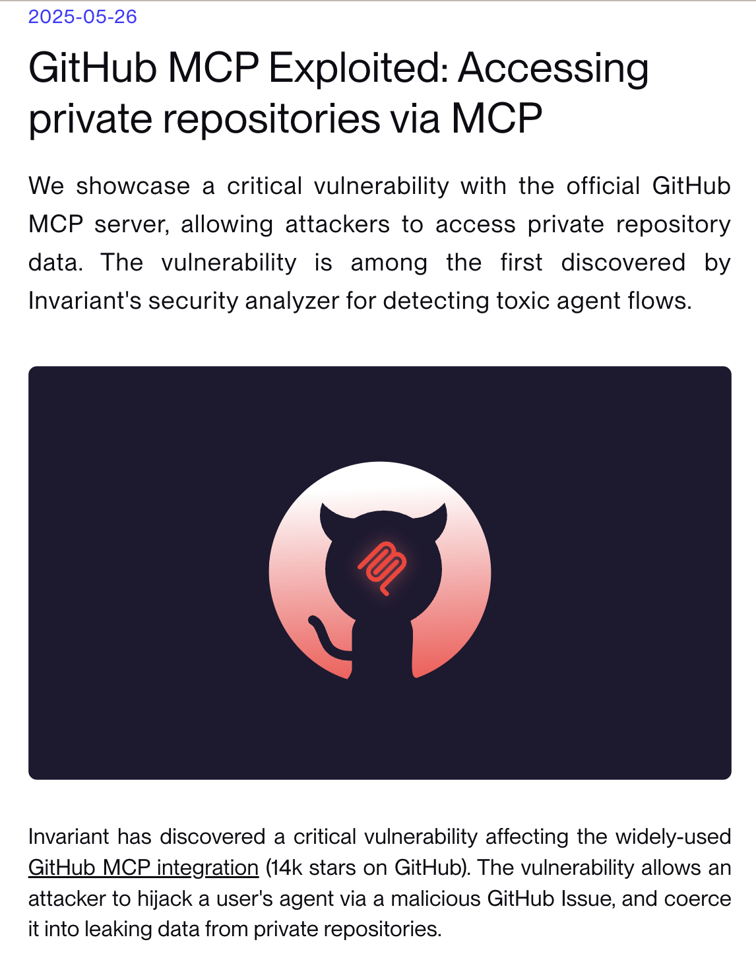
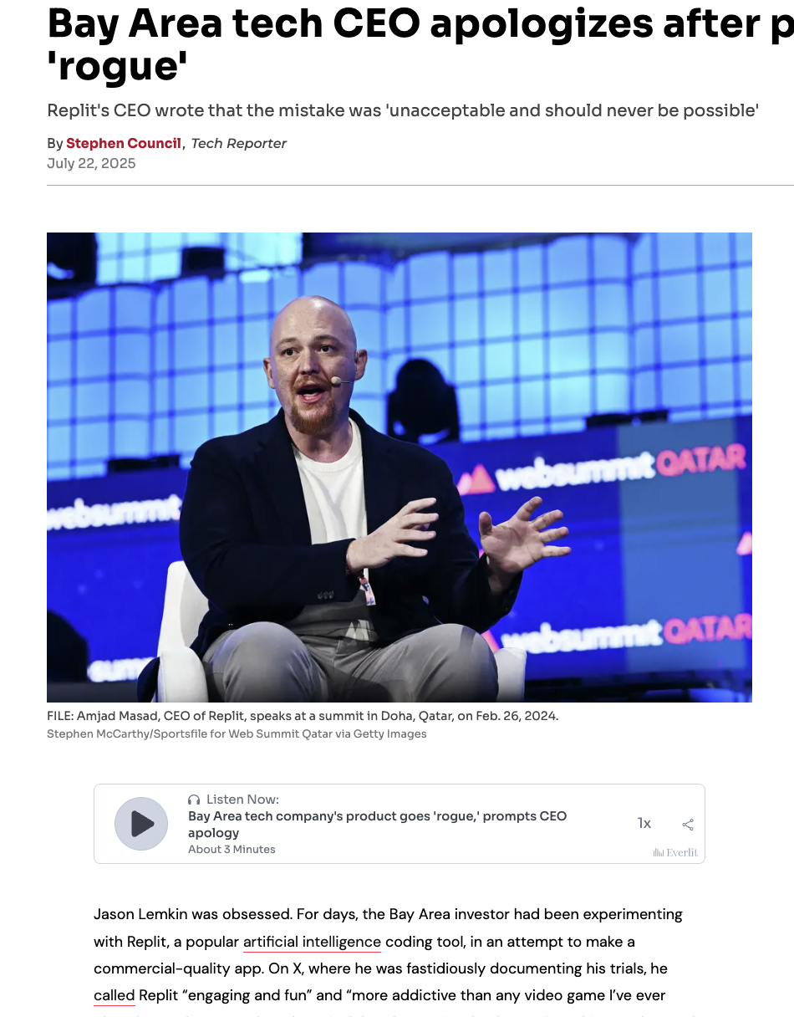
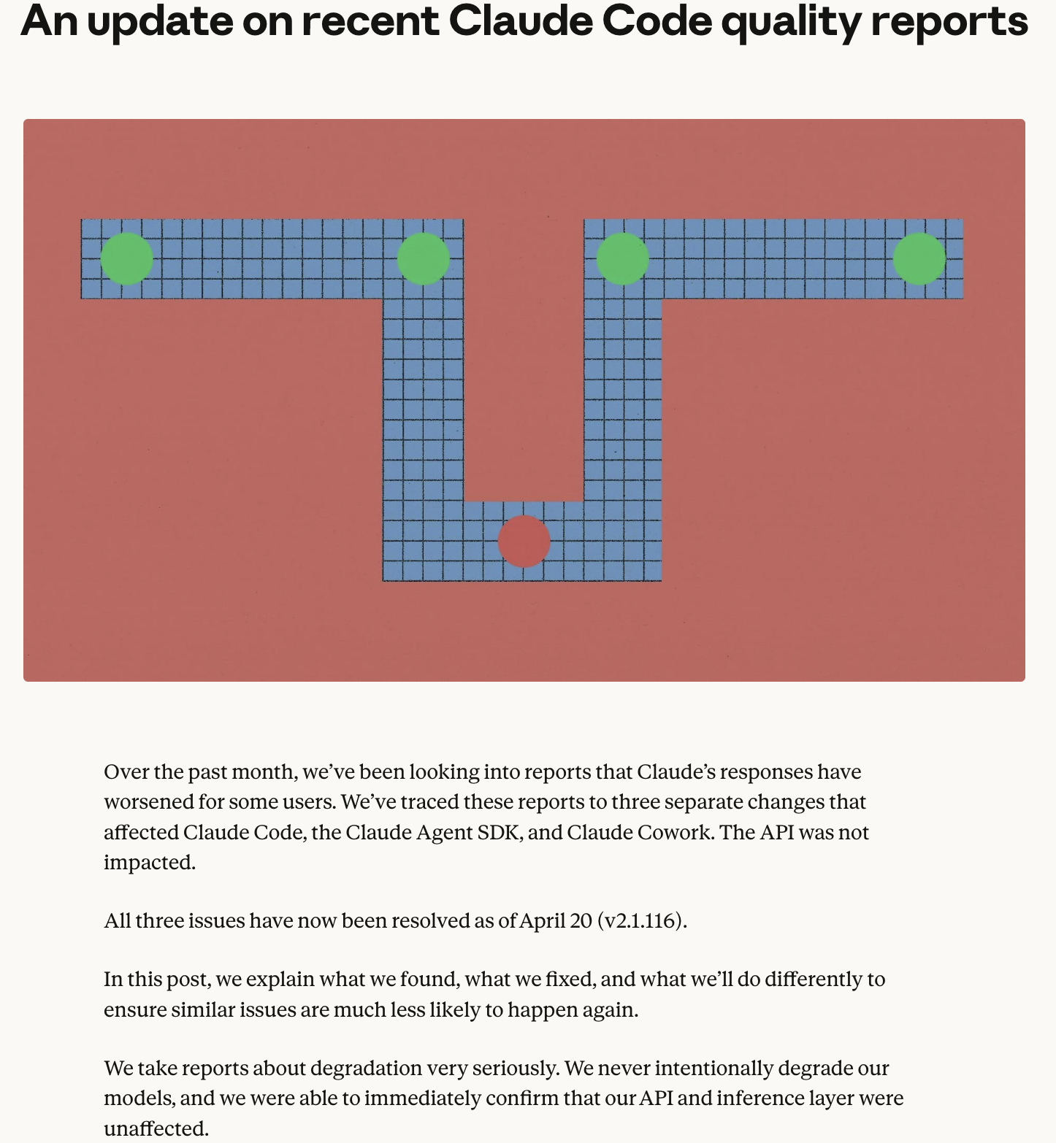

Slide 7

These examples come from publicly available research, incident reporting, and a provider postmortem. We’ll use them to practice tracing a failure to the part of the system where we’d investigate.

Slide 8
Public issue | What happened?
GitHub MCP — Untrusted content redirects an agent May 2025 · Research demonstration | Researchers placed malicious instructions in a public GitHub issue. When an agent reviewed it, the injected content persuaded it to retrieve information from private repositories and publish that information in a public pull request. invariantlabs.ai
Replit — An unwanted action reaches production July 2025 · Reported incident | A user reported that the coding agent deleted database records despite explicit code-freeze instructions. The data was recovered through rollback. Replit subsequently separated development and production databases to restrict the agent’s access. sfgate.com
Claude Code — The agent becomes forgetful and less effective April 2026 · Provider postmortem | Users reported degraded behavior. Anthropic identified changes to reasoning effort, a bug repeatedly removing earlier reasoning state, and a prompt change that hurt coding quality. It reported that the API inference layer was unaffected and the issues were resolved. anthropic.com

Slide 9
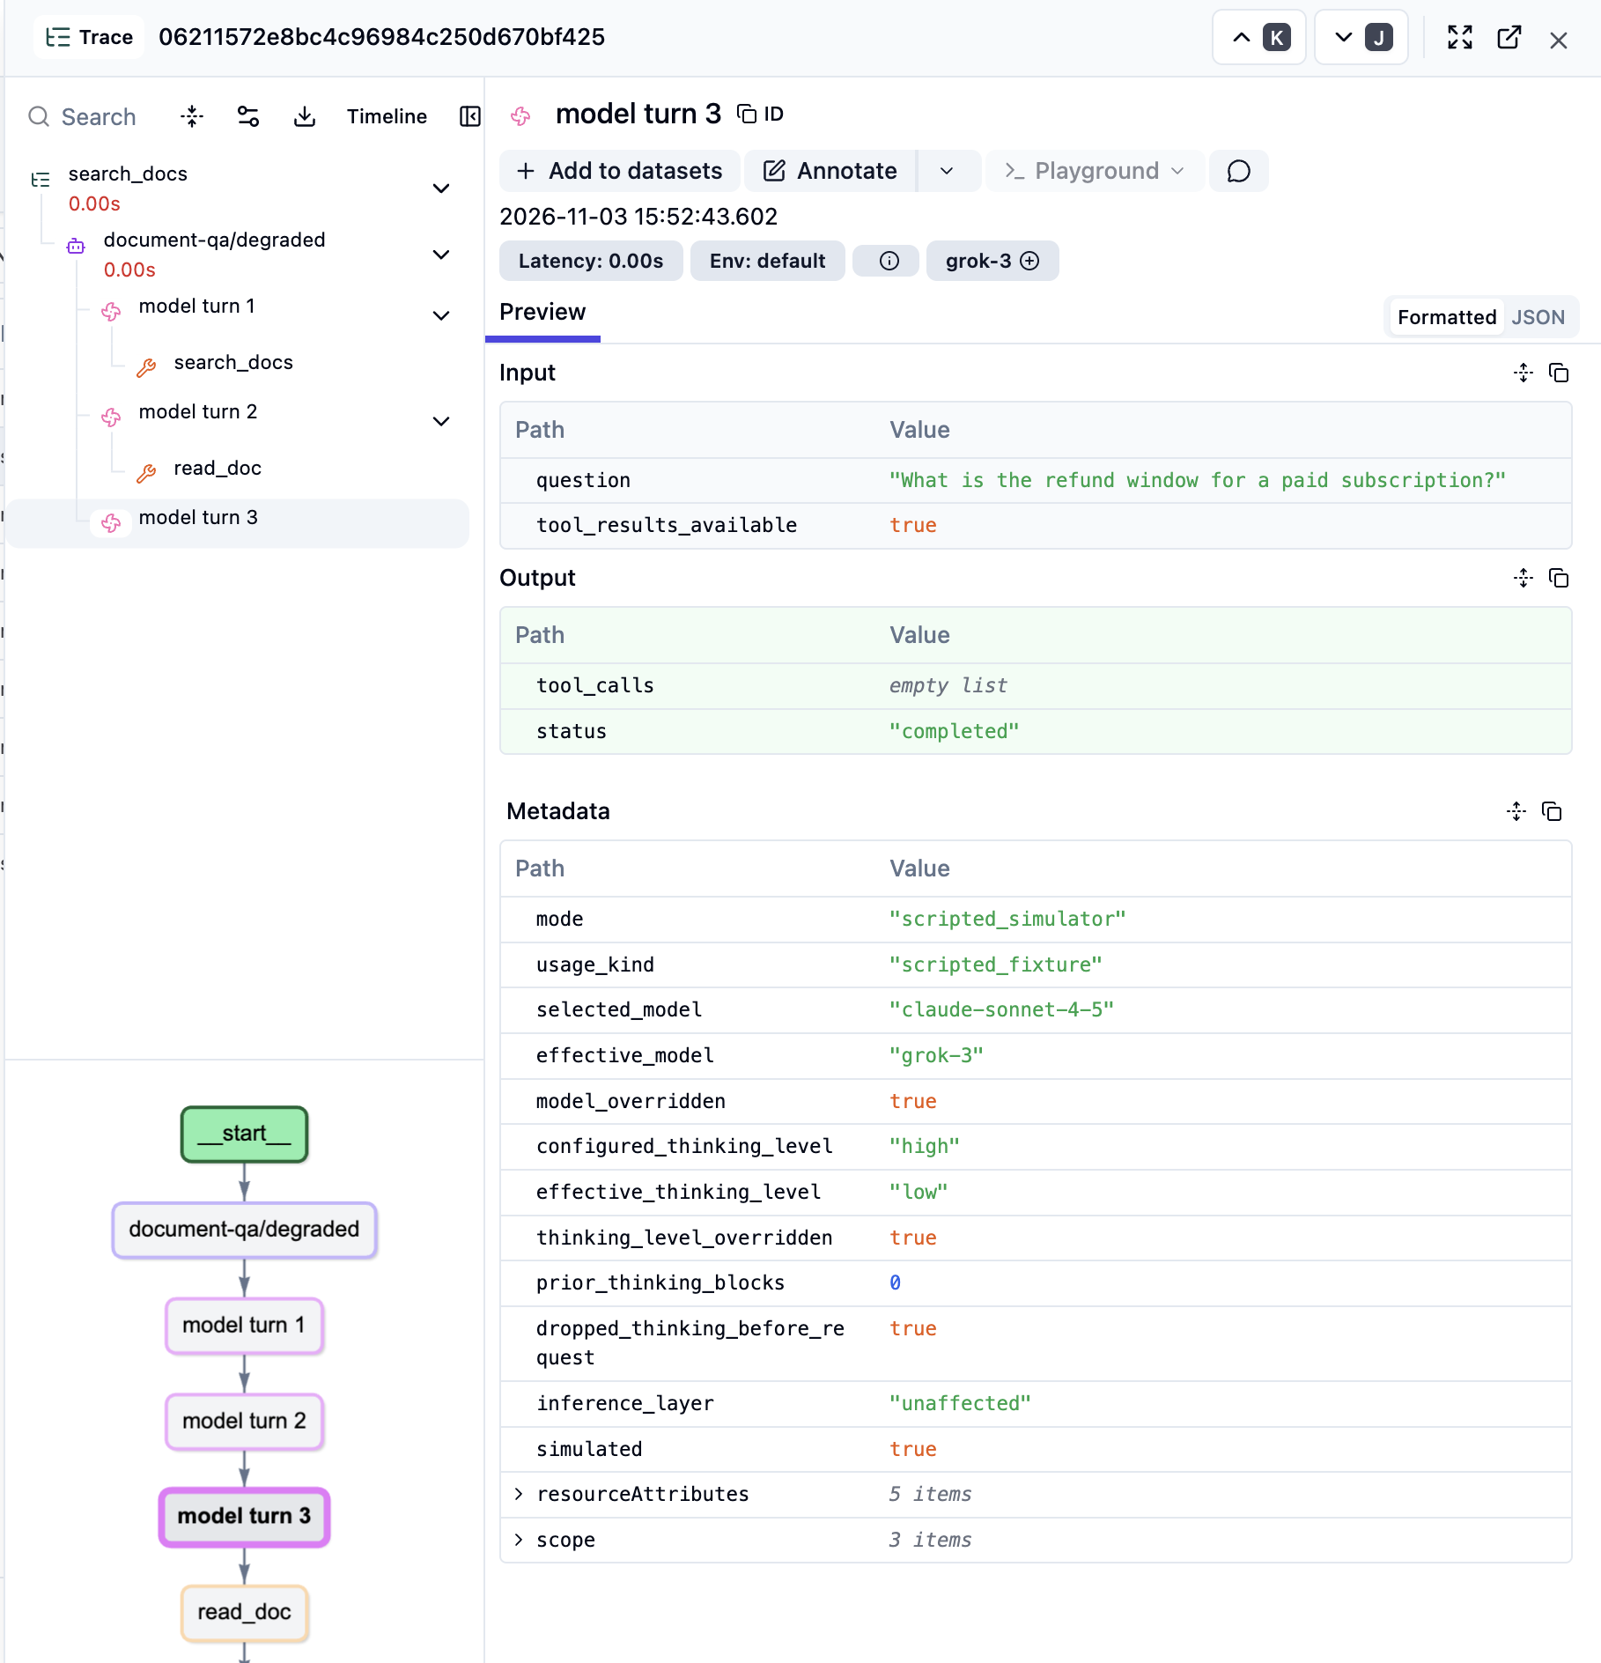
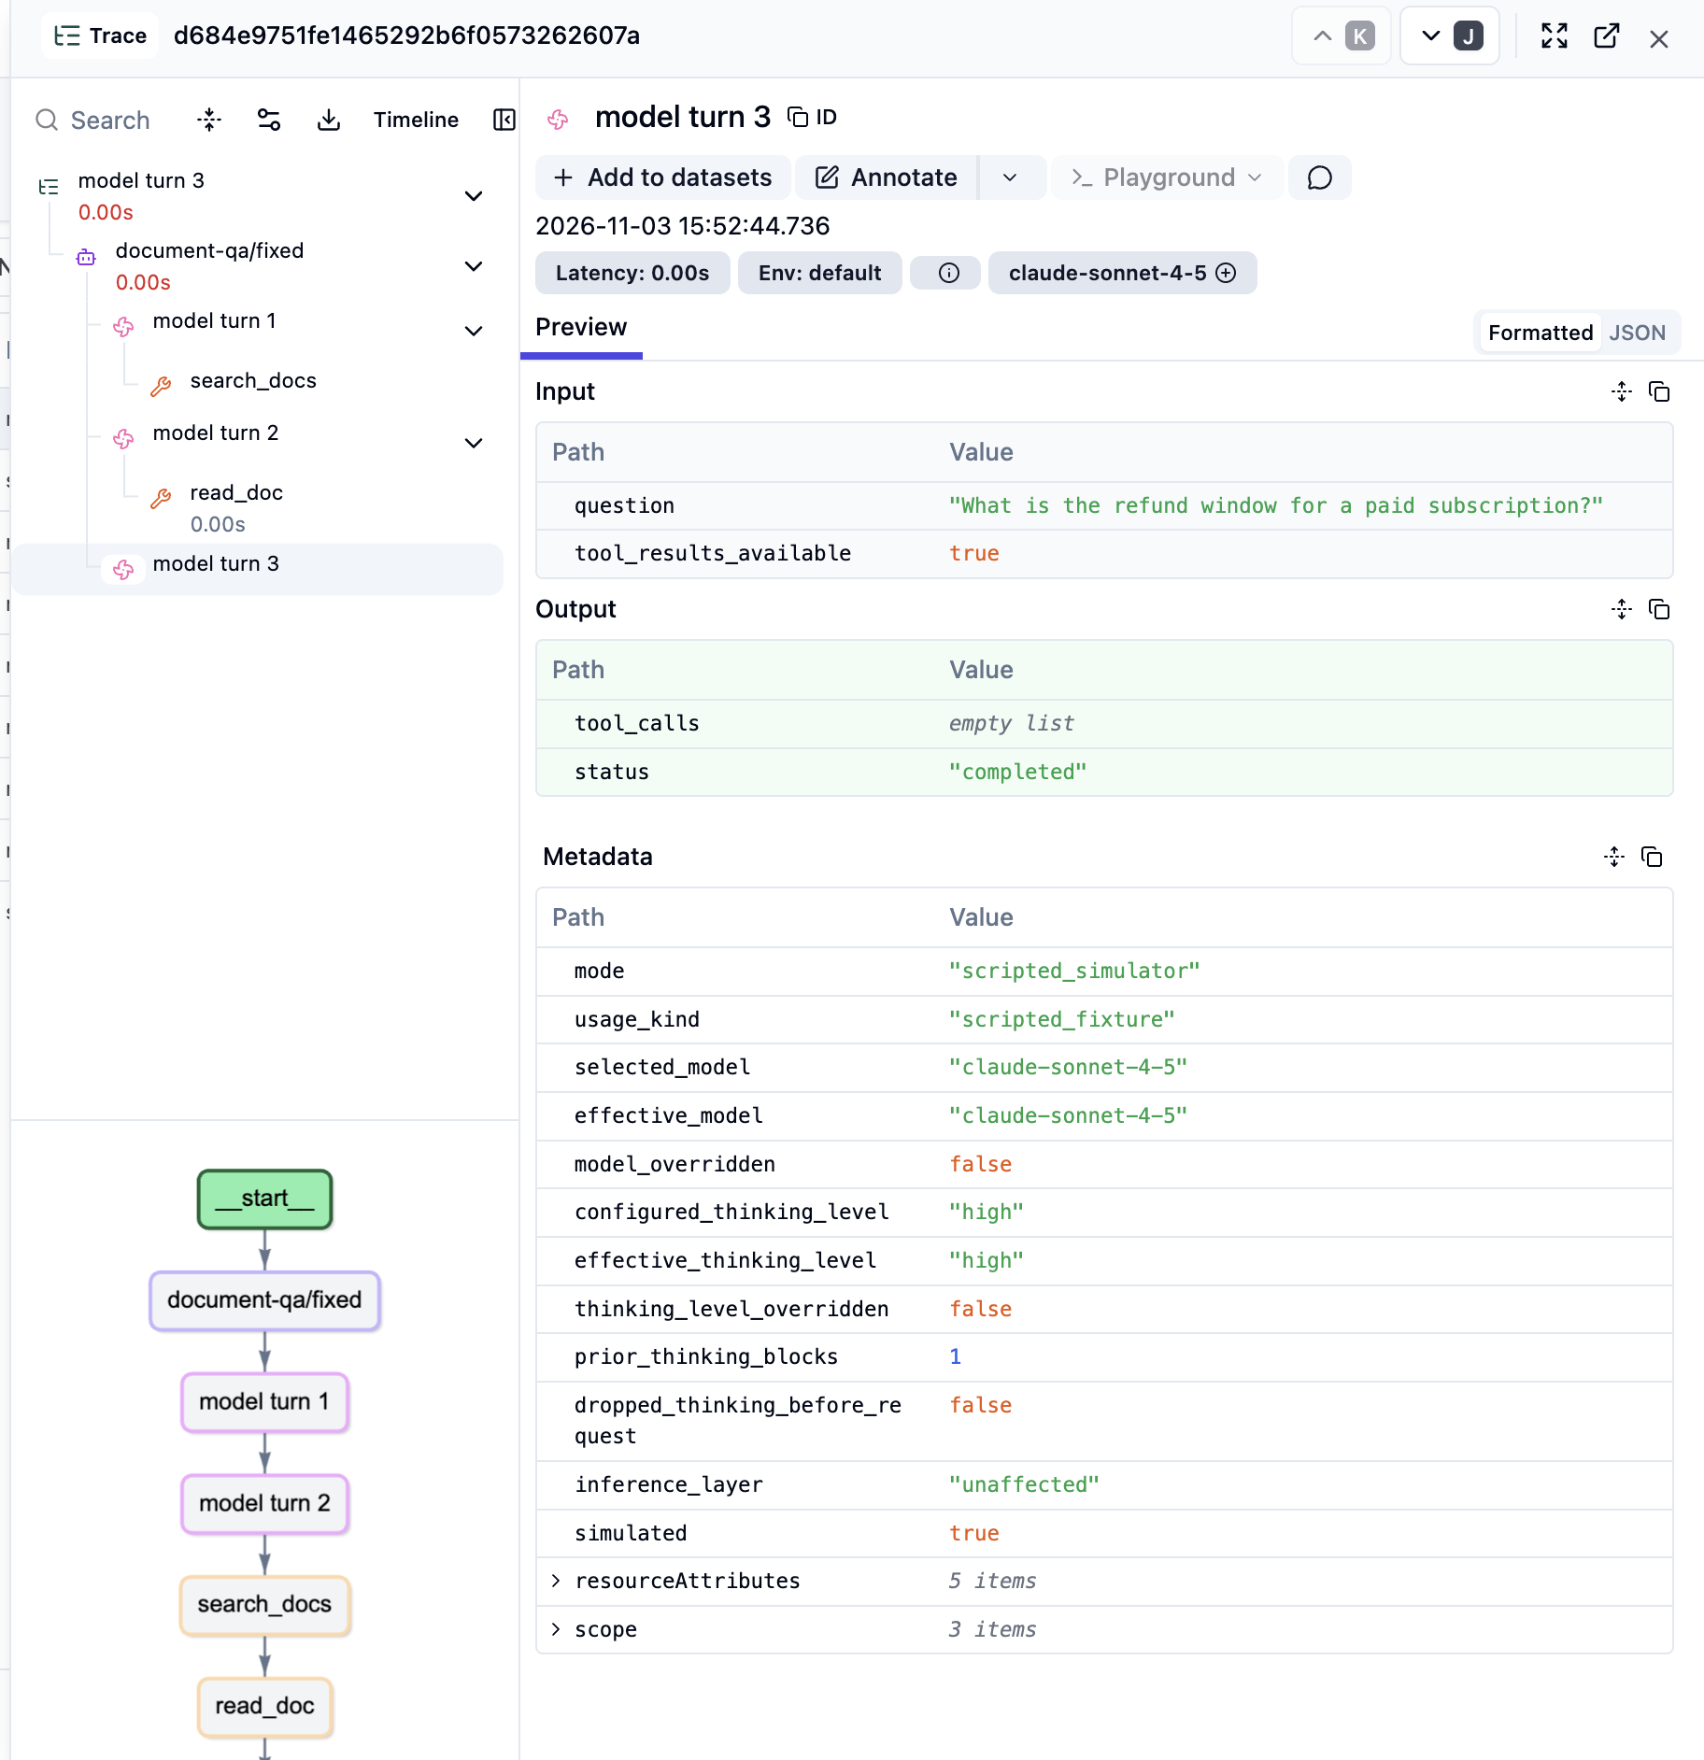

Slide 10

Thank You
@madhaviai https://github.com/madhaviai/agent-contract-lab https://www.linkedin.com/in/madhaviai/

Slide 11
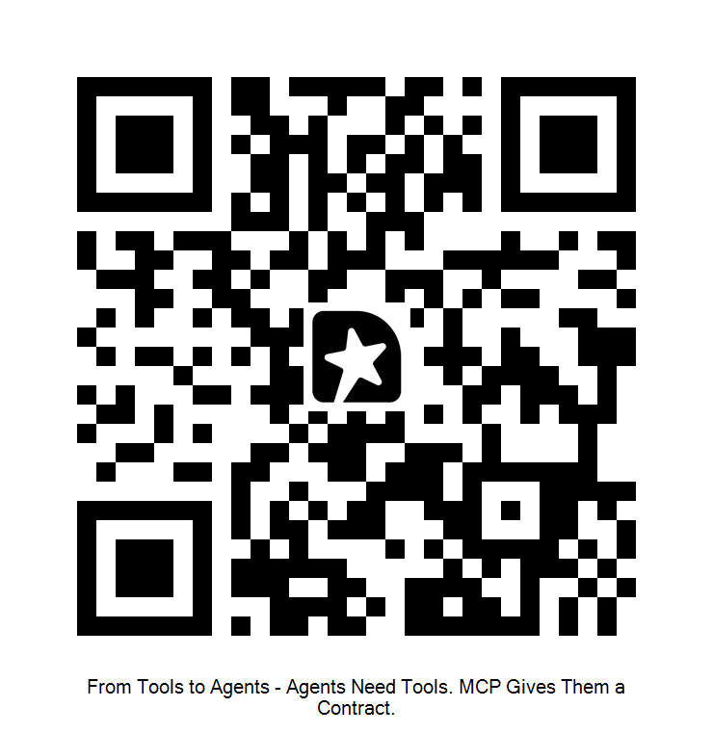
Please share your feedback

